Slide 1

Project: Conversation Dialogue Identification
York University – CSML1010 – Final Project – Group 3: Jerry Khidaroo, Paul Doucet
Instructor: Dr. Annie En-Shiun Lee

Slide 2
Questions
Feedback from Presentations
Project Proposal - both paul and jerry available 1. Problem Definition (3/5) - Can spend more time on clarifying your text classification problem (i.e. what are the classes) 2. Data Cleaning and balancing dataset (4/5) - great presentation of your code work 3. Data Exploration (4/5) - could have more visualizations and eda, but cover the major ones. 4. Others (presentation, graphs/charts/tables, code) (3.5/5) - Can be more fluent in the presentation. Lots of "um“ thank you for covering your plan
Milestone 1 - Jerry presented count methods first then Paul presented word embeddings. 1. Feature Extraction (4.5/5) - tfidf, bow, w2v, glove, fast text 2. Feature Selection (5/5) - minmax scaler, max abs scaler 3. Baseline and Benchmark of Features (5/5) - great summary with tables and graphs and heatmaps! Best so far 4. Others (presentation, graphs/charts/tables, code) (5/5) - very clear and precise results, good job comparing them on one page
Milestone 2 - Paul presented first; Jerry presented second 1. Benchmark Comparison (5/5) - great summaries and nice graphs; great job on hyperparameter optimizations as well! 2. Learning Curves (4/5) - good strategy for better convergence (good problem solving); 3. Ensemble Learning (4/5) - try all 4, great job 4. Others (presentation, graphs/charts/tables, code) (4.5/5) good detailed work ; try presenting f1 scores You might want to group your categorical variables into just a few, such as "auto, coffee, movie, pizza, restaurant, uber/lift", but you are already at 90+ f1 so it's good already Interestingly, why is there a drop at 800 features and another one at 840? your learning curves seem to be converging, good job. Perhaps try having a little bit more data? What is the difference between soft and hard voting? You might go with the voting. It maybe "slower" in real-time (production) but the results may be more robust (i.e. less variance) What is optimized/baseline and tuned/default? I assume the tuning is for hyperparameter and the optimized is for the features? Please conclude if optimized is always better, and how much better are the tuned models (typically). very nice graph for variance by model type, please spend more time describing this Please add a discussion section about the general trends you see in the different combination you tried.
Model interpretation: only certain models (answer Josue’s question on the LIME) Deliverables: Combine PDF files New Methods: What exactly is meant by this
Less is more, be clear with your presentation
Know the point we are trying to drive home

Slide 3
CSML1010 – Group 3
Final Project: Machine Learning Life-cycle
Introduction
Existing Work
Methodology
Results
Discussion
Conclusion
References/Bibliography

Slide 4
1. Introduction
Project Definition: Conversation Identification
The problem we will examine is a supervised multi-class text classification problem.
Goal: The goal is to investigate which supervised machine learning methods will give the best results in classifying the texts from our dataset into the pre-defined categories.
Input: conversation dialogue text and labels Output: model that predicts the “instruction_id” category correctly
Input
Conversation Dialogue text and labels
Machine Learning
Machine Learning Steps
Output
Model that predicts the “instruction_id” category
Notes:
TODO:
Look at getting a better diagram

Slide 5
2. Existing Work
Existing Work
1. Li, Susan, Feb 19, 2018, Multi-Class Text Classification with Scikit-Learn https://towardsdatascience.com/multi-class-text-classification-with-scikit-learn-12f1e60e0a9f | Gives some good examples of Data Exploration.
2. Bansal, Shivam, Jan. 12, 2017, Ultimate Guide to Understand and Implement Natural Language Processing (with codes in Python) https://www.analyticsvidhya.com/blog/2017/01/ultimate-guide-to-understand-implement-natural-language-processing-codes-in-python/ | Has a great overview of many of the steps involved in NLP.
3. Gupta, Shikhar, Jun 12, 2018, Machine Learning Model Evaluation & Selection, Validation strategies for your machine learning model https://heartbeat.fritz.ai/model-evaluation-selection-i-30d803a44ee | Provides a summary of Model Selection and Validation strategies.
4. scikit-learn 0.23.0, 3.2. Tuning the hyper-parameters of an estimator https://scikit-learn.org/stable/modules/grid_search.html#grid-search | Explains what is involved in Hyperparamet Tuning
5. scikit-learn 0.22.2, Receiver Operating Characteristic (ROC) https://scikit-learn.org/stable/auto_examples/model_selection/plot_roc.html | Provides examples of calculating and ploting ROC/AUC curves for Multi-Class Classification Models
6. Smolyakov, Vadim, Aug 22, 2017, Ensemble Learning to Improve Machine Learning Results, How ensemble methods work: bagging, boosting and stacking https://blog.statsbot.co/ensemble-learning-d1dcd548e936 | Discusses 3 types of Ensemble models: Bagging, Boosting and Stacking.
7. Koehrsen, Will, May 18, 2018, A Complete Machine Learning Walk-Through in Python: Part Three, Interpreting a machine learning model and presenting results https://towardsdatascience.com/a-complete-machine-learning-walk-through-in-python-part-three-388834e8804b https://github.com/WillKoehrsen/machine-learning-project-walkthrough/blob/master/Machine%20Learning%20Project%20Part%203.ipynb | Gives a good explanation of Model Interpretability.

Slide 6
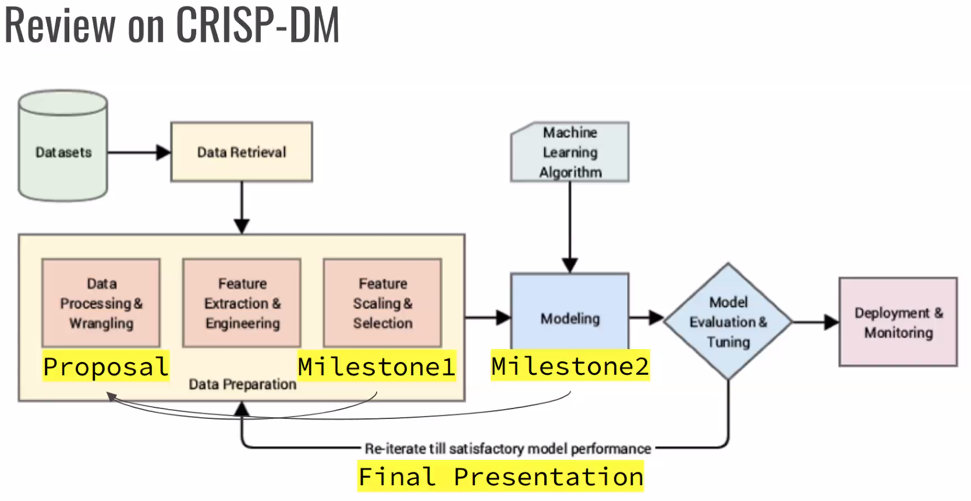
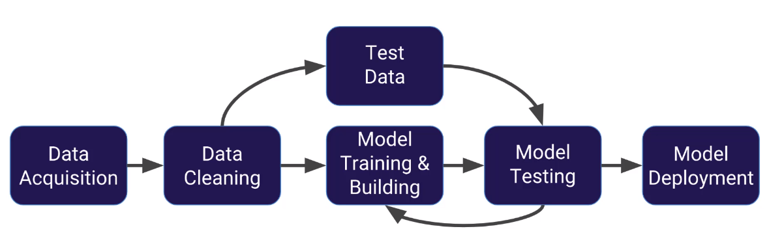
3. Methodology
3. Methodology
1. Data Preparation
2. Cleaning and NLP
3. Data Exploration
4. Feature Engineering and Selection
5. Model Evaluation and Ensemble
6. Model Interpretation
Notes:
TODO:
Clean up what diagram to keep

Slide 7
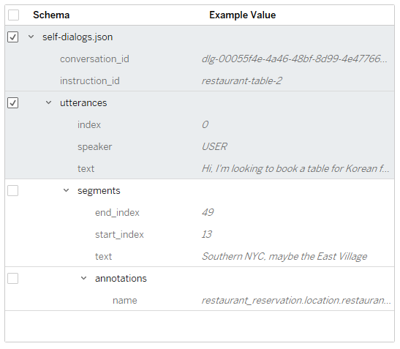
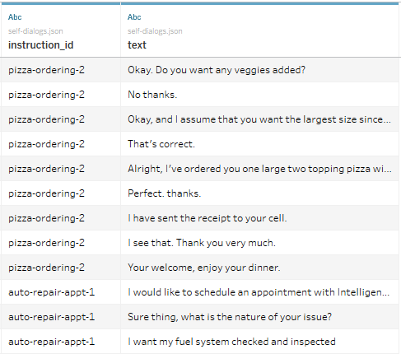
3.1 – Data Preparation
Convert the dataset for use in our project
Data Preparation
Cleaning & NLP
Data Exploration
Feature Engineering & Selection
Model Evaluation and Ensemble
Model Interpretation
The data consists of dialog conversations in JSON format. We plan to import the JSON data and parse the conversation texts into a dataframe that has the concatenated dialog texts and labels.
Next we will perform Data Cleaning and NLP to obtain a normalized corpus that has white-space characters and stop words removed.

Slide 8
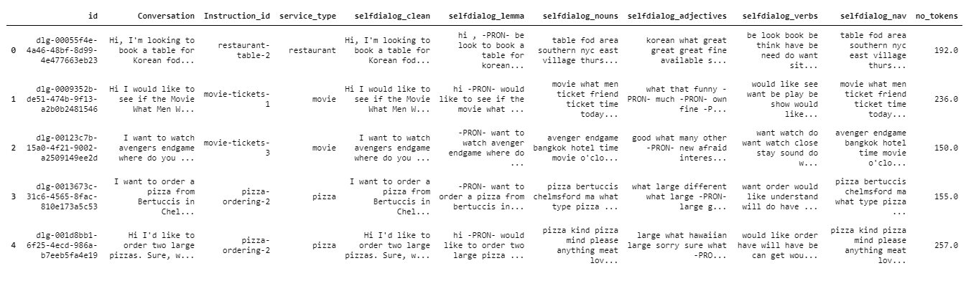
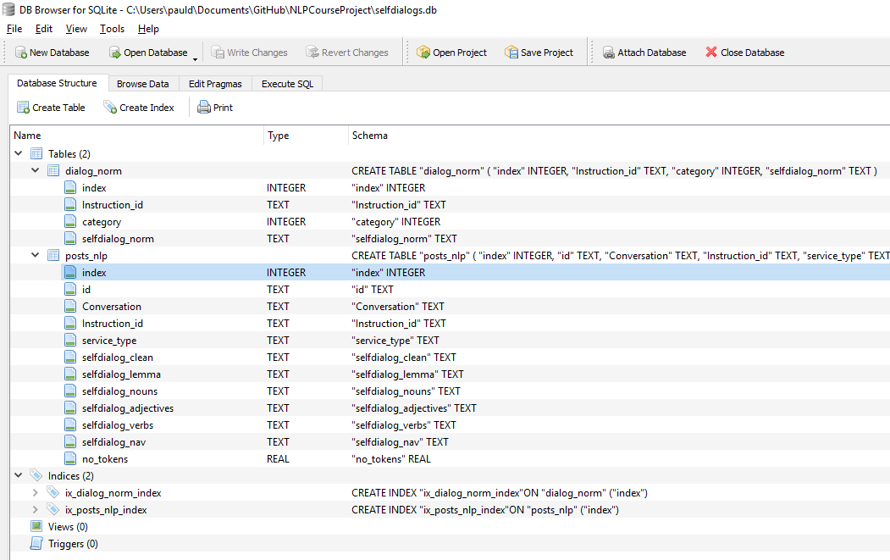
3.2 – Cleaning and NLP
Input | DF_selfDialogs.csv
Output | selfdialogs.db
Data Preparation
Cleaning & NLP
Data Exploration
Feature Engineering & Selection
Model Evaluation and Ensemble
Model Interpretation
Fixed Instruction_id values
Added ‘service_type’ column
Created a database ‘selfdialogs.db’
Cleaned the text using various functions: replace, regular expressions
Iterate and performed NLP on the dataset using ‘spacy’
Store results to database ‘sefldialogs.db’ in table ‘posts_nlp’

Slide 9
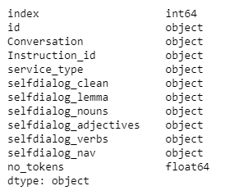
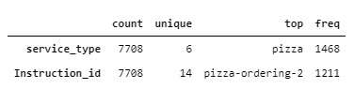
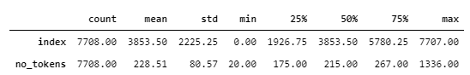
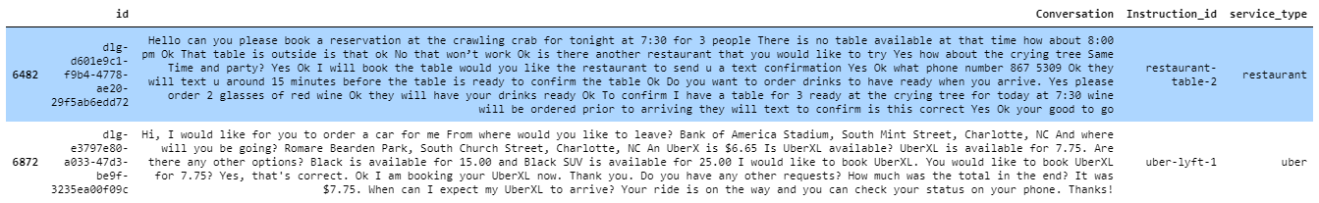
3.3 – Data Exploration
Input | selfdialogs.db
Output
Data Preparation
Cleaning & NLP
Data Exploration
Feature Engineering & Selection
Model Evaluation and Ensemble
Model Interpretation
Word Exploration
Creating Token List
Exploring Word Clouds
Exploring Complexity
Statistical Analysis
Categorical Distribution
Statistical Analysis

Slide 10
3.3 – Data Exploration
Input | selfdialogs.db
Output
Data Preparation
Cleaning & NLP
Data Exploration
Feature Engineering & Selection
Model Evaluation and Ensemble
Model Interpretation
Word Exploration
Creating Token List
Exploring Word Clouds
Exploring Complexity
Statistical Analysis
Categorical Distribution

Slide 11
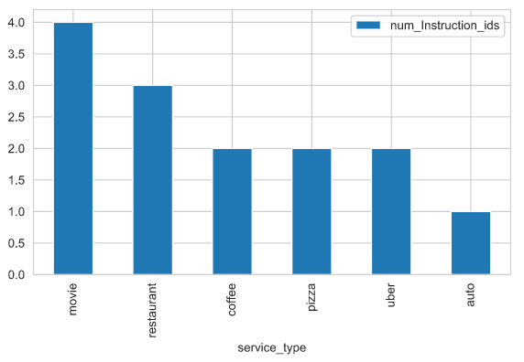
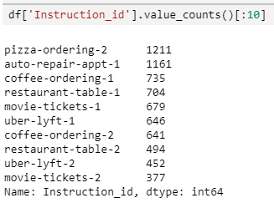
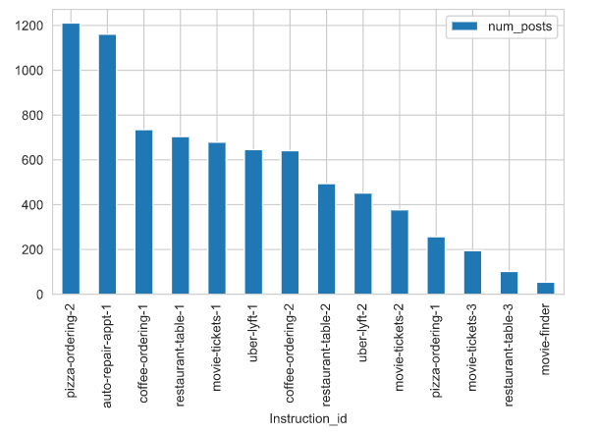
3.3 – Data Exploration
Input | selfdialogs.db
Output
Data Preparation
Cleaning & NLP
Data Exploration
Feature Engineering & Selection
Model Evaluation and Ensemble
Model Interpretation
Statistical Analysis
Categorical Distribution
Exploring Word Clouds
Exploring Complexity
Ex

Slide 12
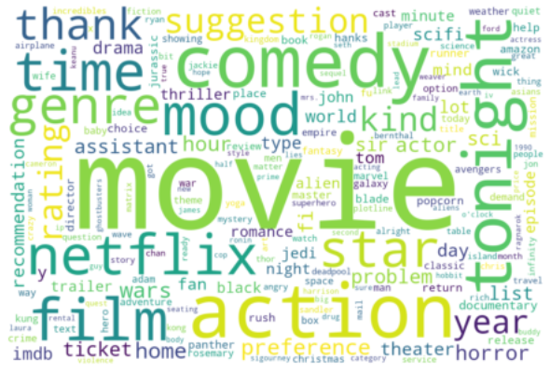
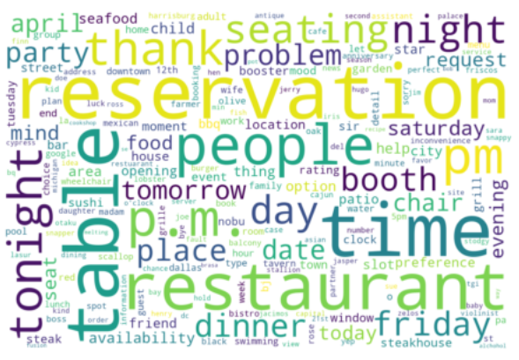
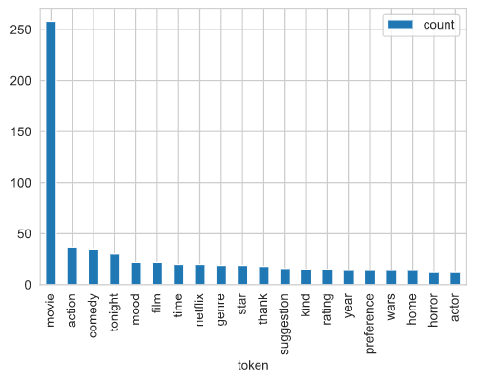
3.3 – Data Exploration
Input | selfdialogs.db
Output
Data Preparation
Cleaning & NLP
Data Exploration
Feature Engineering & Selection
Model Evaluation and Ensemble
Model Interpretation
Creating Token List
Create a token list from the ‘sub_df’
Review most common words
Removed stopwords
‘freq_df’ contains tokens and count
Exploring Word Clouds
Created and displayed word clouds using the tokens created above and a second one
Exploring Complexity
Reviewed for service type: average number of tokens; distribution of tokens; printed outliers; compared # of tokens per ‘instruction_id’
movie-finder
Restaurant-table-3
Notes:
TODO: Get a graph for the second word cloud

Slide 13
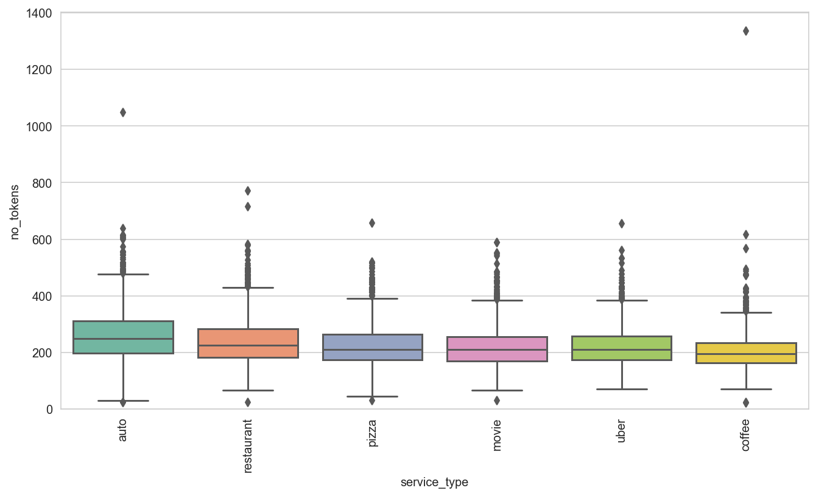
3.3 – Data Exploration
Input | selfdialogs.db
Output
Data Preparation
Cleaning & NLP
Data Exploration
Feature Engineering & Selection
Model Evaluation and Ensemble
Model Interpretation
Creating Token List
Create a token list from the ‘sub_df’
Review most common words
Removed stopwords
‘freq_df’ contains tokens and count
Exploring Word Clouds
Created and displayed word clouds using the tokens created above and a second one
Exploring Complexity
Reviewed for service type: average number of tokens; distribution of tokens; printed outliers; compared # of tokens per ‘instruction_id’

Slide 14
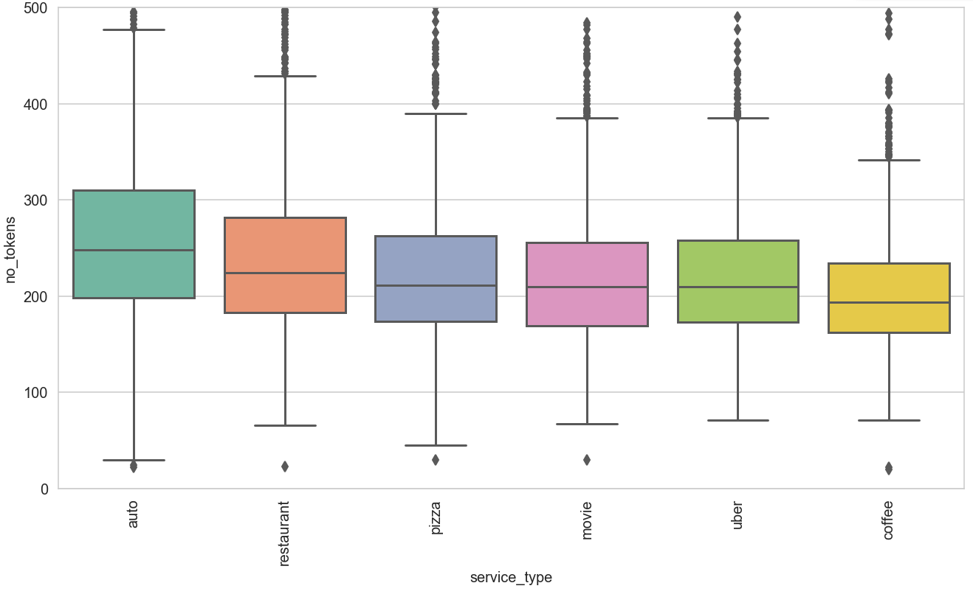
3.3 – Data Exploration
Input | selfdialogs.db
Output
Data Preparation
Cleaning & NLP
Data Exploration
Feature Engineering & Selection
Model Evaluation and Ensemble
Model Interpretation
Creating Token List
Create a token list from the ‘sub_df’
Review most common words
Removed stopwords
‘freq_df’ contains tokens and count
Exploring Word Clouds
Created and displayed word clouds using the tokens created above and a second one
Exploring Complexity
Reviewed for service type: average number of tokens; distribution of tokens; printed outliers; compared # of tokens per ‘instruction_id’

Slide 15
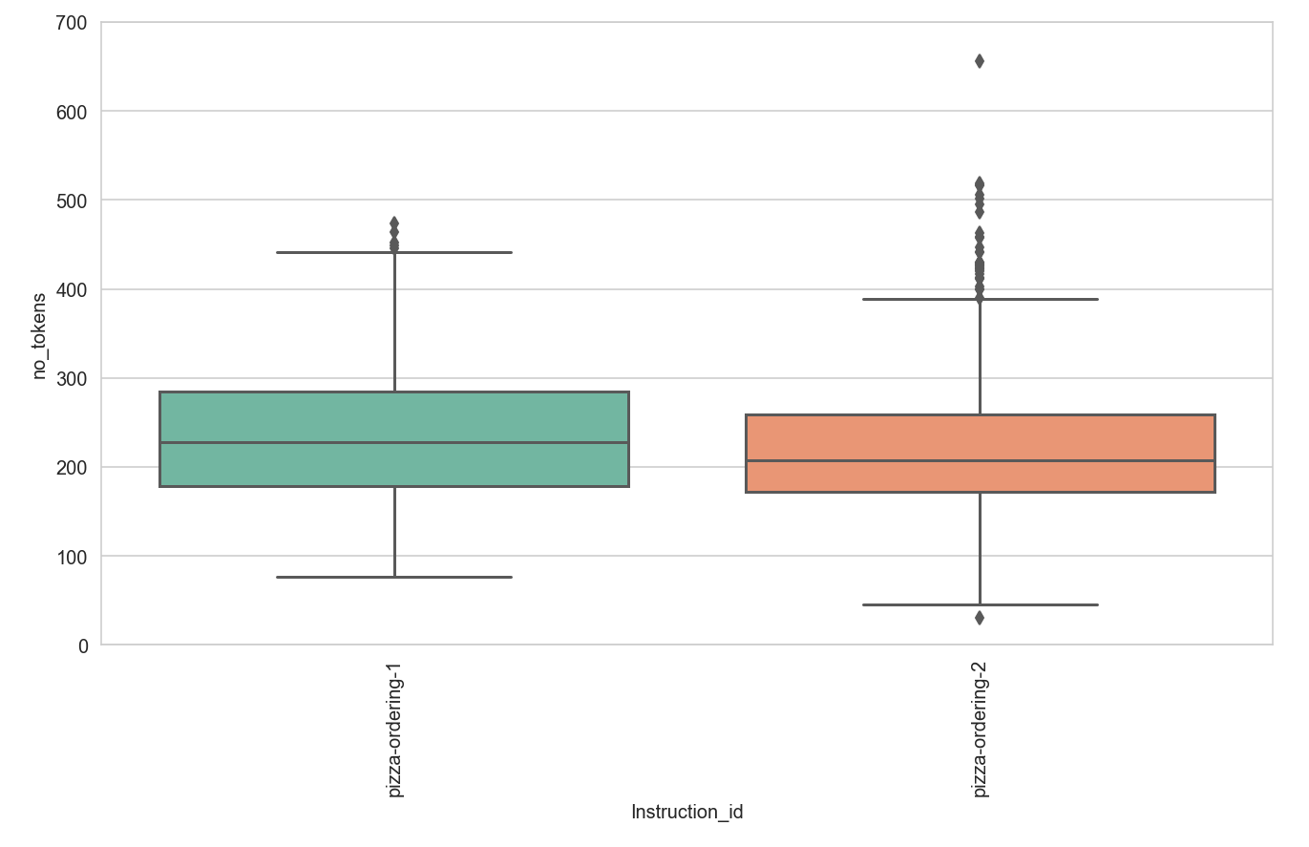
3.3 – Data Exploration
Input | selfdialogs.db
Output
Data Preparation
Cleaning & NLP
Data Exploration
Feature Engineering & Selection
Model Evaluation and Ensemble
Model Interpretation
Creating Token List
Create a token list from the ‘sub_df’
Review most common words
Removed stopwords
‘freq_df’ contains tokens and count
Exploring Word Clouds
Created and displayed word clouds using the tokens created above and a second one
Exploring Complexity
Reviewed for service type: average number of tokens; distribution of tokens; printed outliers; compared # of tokens per ‘instruction_id’

Slide 16
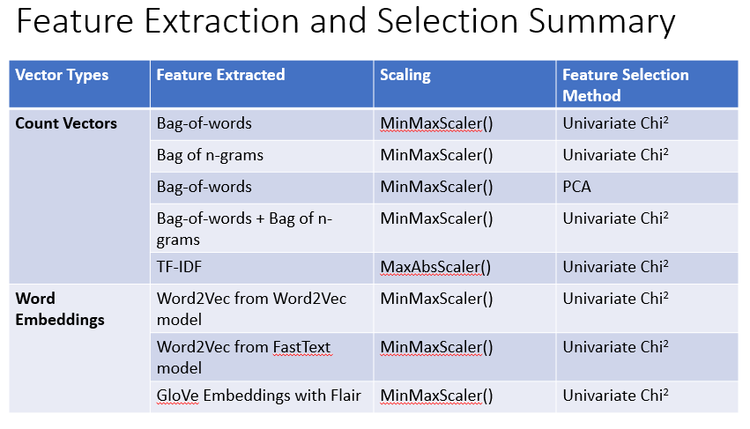
3.4 – Feature Engineering & Selection```
Input | selfdialogs.db
Output | dialog_norm.csv
Data Preparation
Cleaning & NLP
Data Exploration
Feature Engineering & Selection
Model Evaluation and Ensemble
Model Interpretation
Merge some very similar ‘instruction_id’
Do some additional cleaning using ‘nltk’
Stored new file ‘dialog_norm.csv’ with the changes made above
Get a sample of records
Generate Corpus List: ‘doc_lst’
Build Vocabulary
Build pair generator (context_words, target words)
Setup dictionaries to cross reference ‘Instruction_id’ and ‘category’
Split data in Train and Test sets

Slide 17
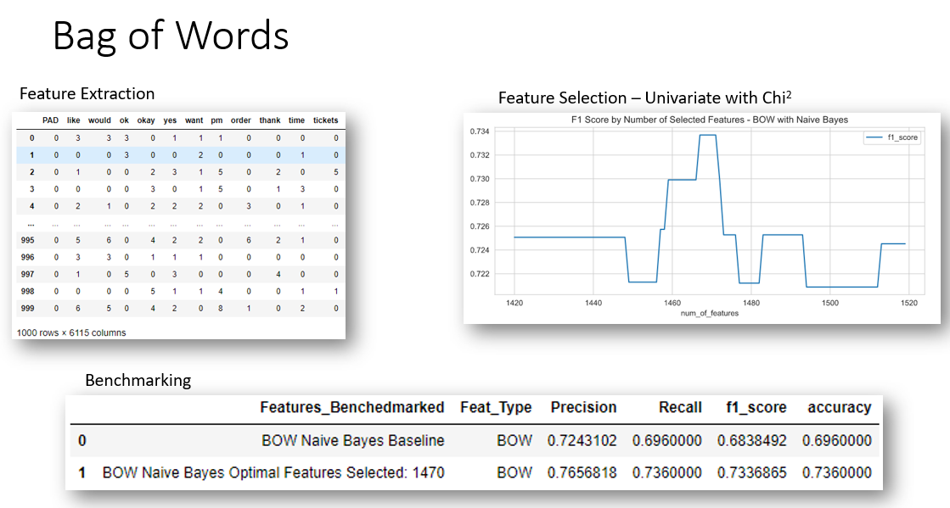
3.4 – Feature Engineering & Selection
Input | selfdialogs.db
Output | dialog_norm.csv
Data Preparation
Cleaning & NLP
Data Exploration
Feature Engineering & Selection
Model Evaluation and Ensemble
Model Interpretation
Features Extracted:
Counting Methods
Bag of Words
Bag of N-Grams
PCA on Bag of Words
Combined Features: BOW + Bag of N-Grams
TF-IDF
Word Embeddings
Word2Vec
Word2Vec from FastText
Glove from FLAIR
Feature Selection Method:
Univariate – SelectKBest “Chi2’
PCA
Notes:
TODO: Add some screen shots or diagrams of the different feature extractions

Slide 18
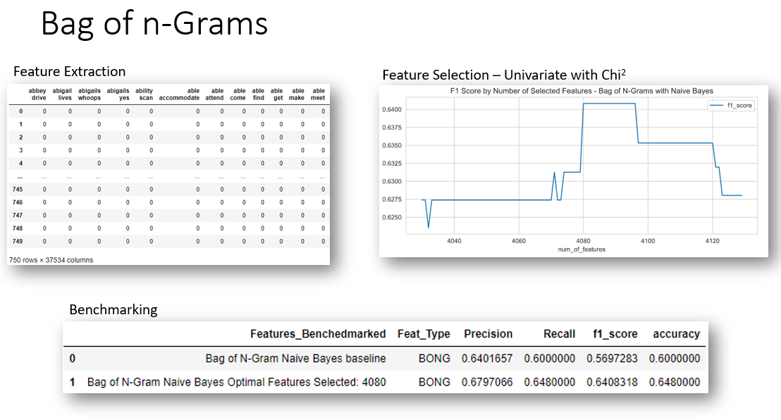
3.4 – Feature Engineering & Selection
Input | selfdialogs.db
Output | dialog_norm.csv
Data Preparation
Cleaning & NLP
Data Exploration
Feature Engineering & Selection
Model Evaluation and Ensemble
Model Interpretation
Features Extracted:
Counting Methods
Bag of Words
Bag of N-Grams
PCA on Bag of Words
Combined Features: BOW + Bag of N-Grams
TF-IDF
Word Embeddings
Word2Vec
Word2Vec from FastText
Glove from FLAIR
Feature Selection Method:
Univariate – SelectKBest “Chi2’
PCA
Notes:
TODO: Add some screen shots or diagrams of the different feature extractions

Slide 19
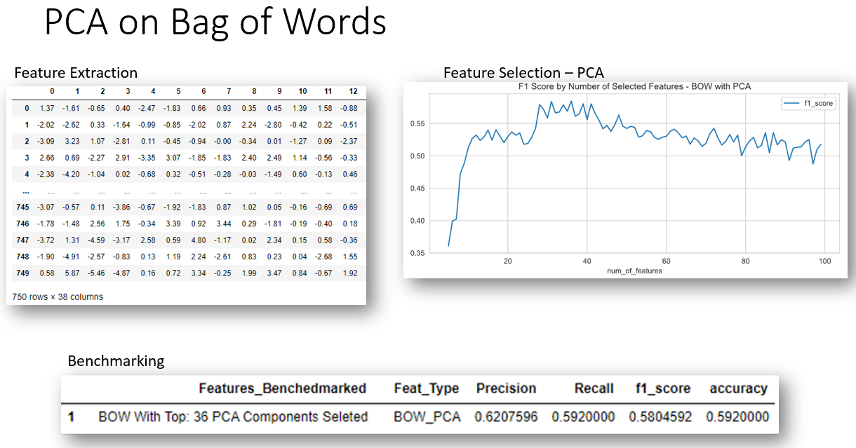
3.4 – Feature Engineering & Selection
Input | selfdialogs.db
Output | dialog_norm.csv
Data Preparation
Cleaning & NLP
Data Exploration
Feature Engineering & Selection
Model Evaluation and Ensemble
Model Interpretation
Features Extracted:
Counting Methods
Bag of Words
Bag of N-Grams
PCA on Bag of Words
Combined Features: BOW + Bag of N-Grams
TF-IDF
Word Embeddings
Word2Vec
Word2Vec from FastText
Glove from FLAIR
Feature Selection Method:
Univariate – SelectKBest “Chi2’
PCA
Notes:
TODO: Add some screen shots or diagrams of the different feature extractions

Slide 20
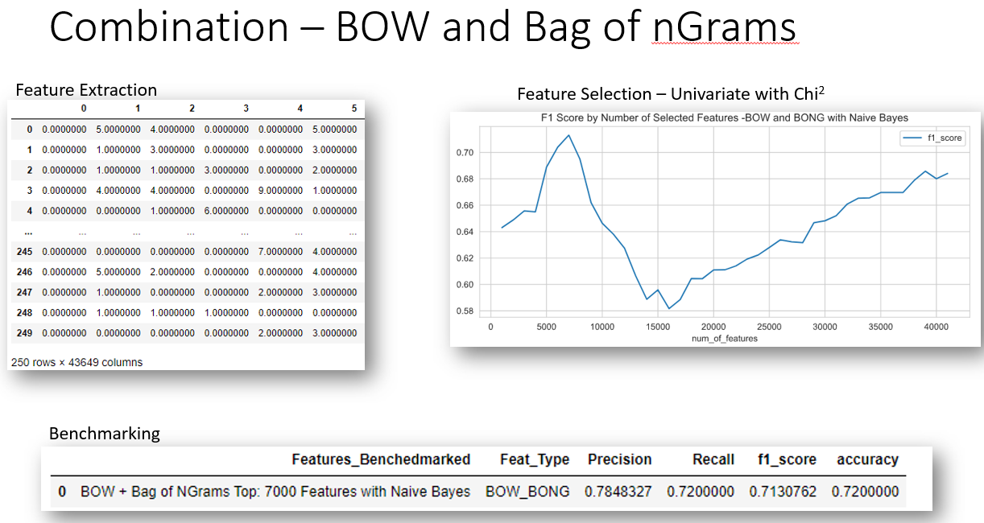
3.4 – Feature Engineering & Selection
Input | selfdialogs.db
Output | dialog_norm.csv
Data Preparation
Cleaning & NLP
Data Exploration
Feature Engineering & Selection
Model Evaluation and Ensemble
Model Interpretation
Features Extracted:
Counting Methods
Bag of Words
Bag of N-Grams
PCA on Bag of Words
Combined Features: BOW + Bag of N-Grams
TF-IDF
Word Embeddings
Word2Vec
Word2Vec from FastText
Glove from FLAIR
Feature Selection Method:
Univariate – SelectKBest “Chi2’
PCA
Notes:
TODO: Add some screen shots or diagrams of the different feature extractions

Slide 21
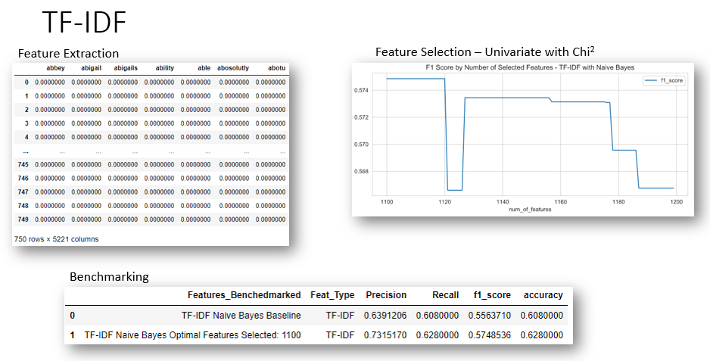
3.4 – Feature Engineering & Selection
Input | selfdialogs.db
Output | dialog_norm.csv
Data Preparation
Cleaning & NLP
Data Exploration
Feature Engineering & Selection
Model Evaluation and Ensemble
Model Interpretation
Features Extracted:
Counting Methods
Bag of Words
Bag of N-Grams
PCA on Bag of Words
Combined Features: BOW + Bag of N-Grams
TF-IDF
Word Embeddings
Word2Vec
Word2Vec from FastText
Glove from FLAIR
Feature Selection Method:
Univariate – SelectKBest “Chi2’
PCA
Notes:
TODO: Add some screen shots or diagrams of the different feature extractions

Slide 22
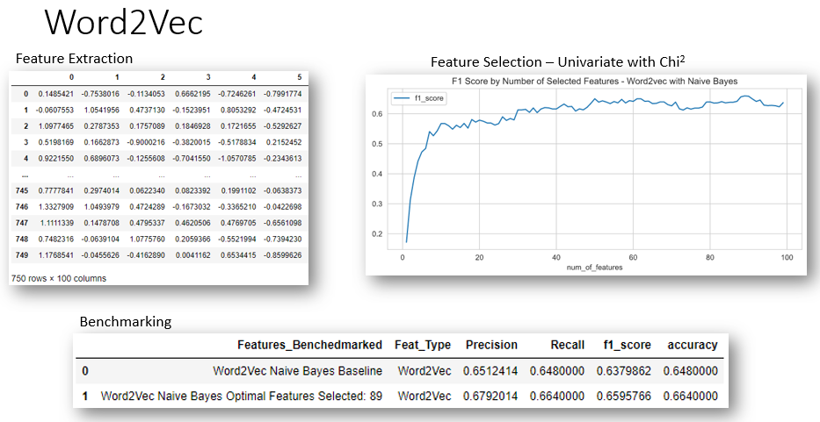
3.4 – Feature Engineering & Selection
Input | selfdialogs.db
Output | dialog_norm.csv
Data Preparation
Cleaning & NLP
Data Exploration
Feature Engineering & Selection
Model Evaluation and Ensemble
Model Interpretation
Features Extracted:
Counting Methods
Bag of Words
Bag of N-Grams
PCA on Bag of Words
Combined Features: BOW + Bag of N-Grams
TF-IDF
Word Embeddings
Word2Vec
Word2Vec from FastText
Glove from FLAIR
Feature Selection Method:
Univariate – SelectKBest “Chi2’
PCA

Slide 23
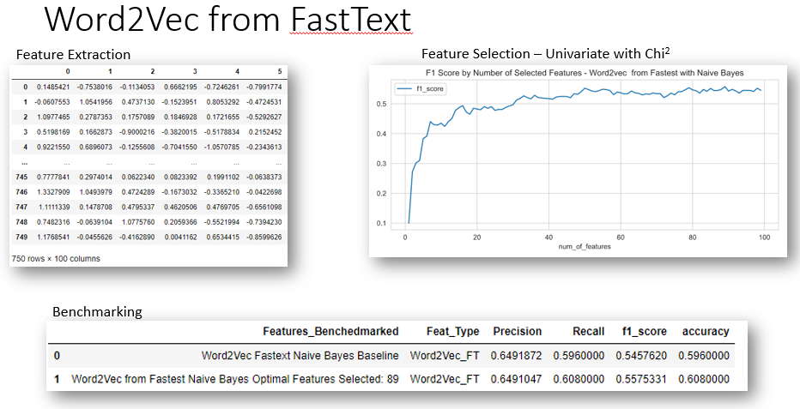
3.4 – Feature Engineering & Selection
Input | selfdialogs.db
Output | dialog_norm.csv
Data Preparation
Cleaning & NLP
Data Exploration
Feature Engineering & Selection
Model Evaluation and Ensemble
Model Interpretation
Features Extracted:
Counting Methods
Bag of Words
Bag of N-Grams
PCA on Bag of Words
Combined Features: BOW + Bag of N-Grams
TF-IDF
Word Embeddings
Word2Vec
Word2Vec from FastText
Glove from FLAIR
Feature Selection Method:
Univariate – SelectKBest “Chi2’
PCA

Slide 24
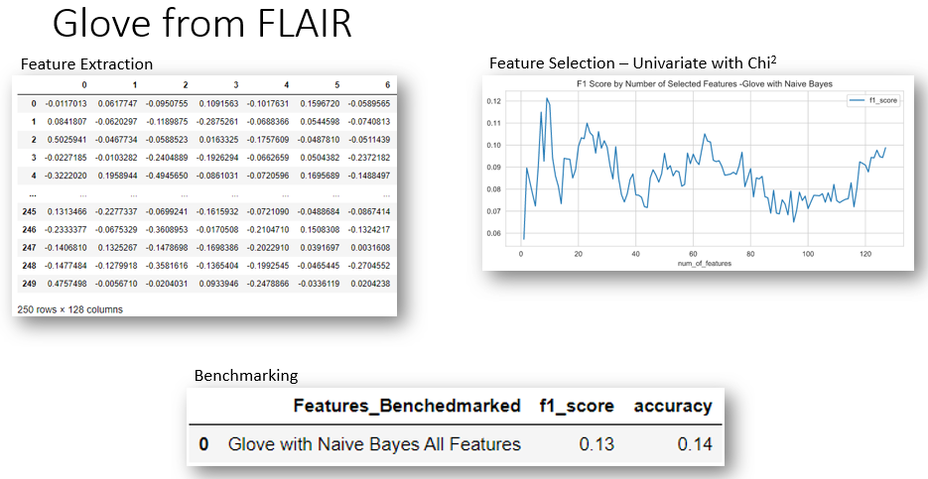
3.4 – Feature Engineering & Selection
Input | selfdialogs.db
Output | dialog_norm.csv
Data Preparation
Cleaning & NLP
Data Exploration
Feature Engineering & Selection
Model Evaluation and Ensemble
Model Interpretation
Features Extracted:
Counting Methods
Bag of Words
Bag of N-Grams
PCA on Bag of Words
Combined Features: BOW + Bag of N-Grams
TF-IDF
Word Embeddings
Word2Vec
Word2Vec from FastText
Glove from FLAIR
Feature Selection Method:
Univariate – SelectKBest “Chi2’
PCA

Slide 25
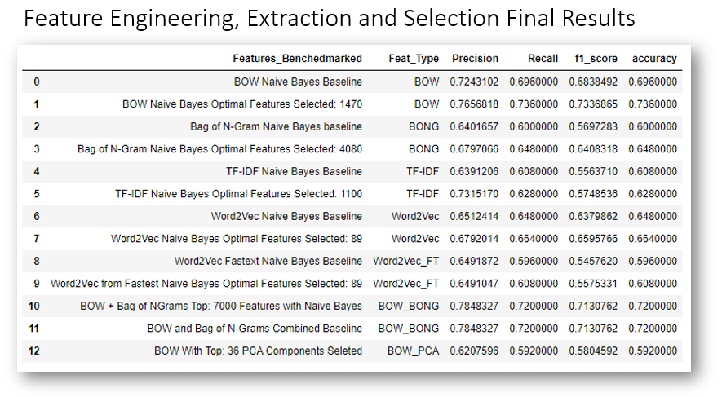
3.4 – Feature Engineering & Selection
Input | selfdialogs.db
Output | dialog_norm.csv
Data Preparation
Cleaning & NLP
Data Exploration
Feature Engineering & Selection
Model Evaluation and Ensemble
Model Interpretation
Features Extracted:
Counting Methods
Bag of Words
Bag of N-Grams
PCA on Bag of Words
Combined Features: BOW + Bag of N-Grams
TF-IDF
Word Embeddings
Word2Vec
Word2Vec from FastText
Glove from FLAIR
Feature Selection Method:
Univariate – SelectKBest “Chi2’
PCA

Slide 26
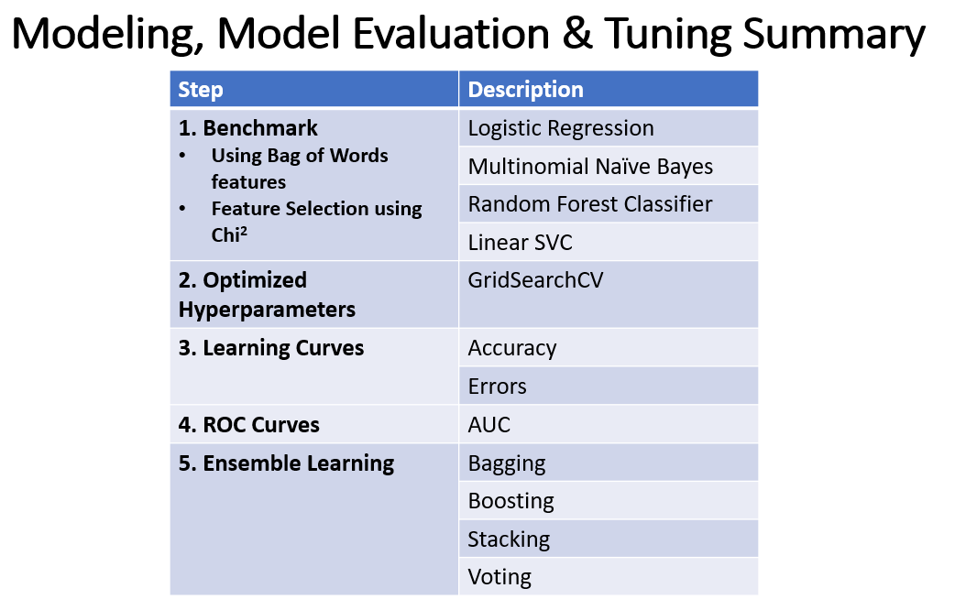
3.5 – Model Evaluation & Ensemble
Input | selfdialogs.db
Output | dialog_norm.csv
Data Preparation
Cleaning & NLP
Data Exploration
Feature Engineering & Selection
Model Evaluation and Ensemble
Model Interpretation
Features Selected
Bag of Words
Univariate SelectKBest - chi2
Models Benchmark
Logistic Regression
Multinomial Naïve Bayes
Random Forest Classifier
Linear SVC
Optimized Parameters
GridSearchCV
Learning Curves
F1-Score
Errors
ROC Curves
AUC
Ensemble Learning
Bagging
Boosting
Stacking
Voting

Slide 27
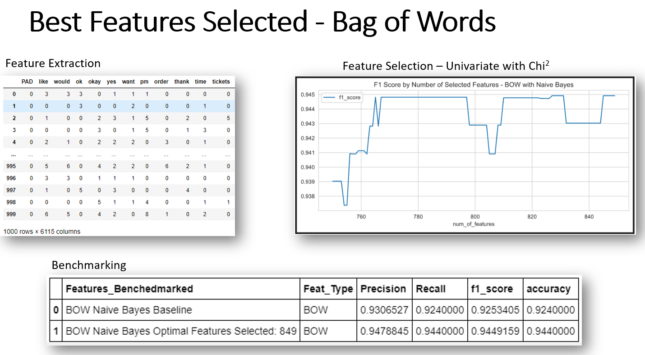
3.5 – Model Evaluation & Ensemble
Input | selfdialogs.db
Output | dialog_norm.csv
Data Preparation
Cleaning & NLP
Data Exploration
Feature Engineering & Selection
Model Evaluation and Ensemble
Model Interpretation
Features Selected
Bag of Words
Univariate SelectKBest - chi2
Models Benchmark
Logistic Regression
Multinomial Naïve Bayes
Random Forest Classifier
Linear SVC
Optimized Parameters
GridSearchCV
Learning Curves
F1-Score
Errors
ROC Curves
AUC
Ensemble Learning
Bagging
Boosting
Stacking
Voting

Slide 28
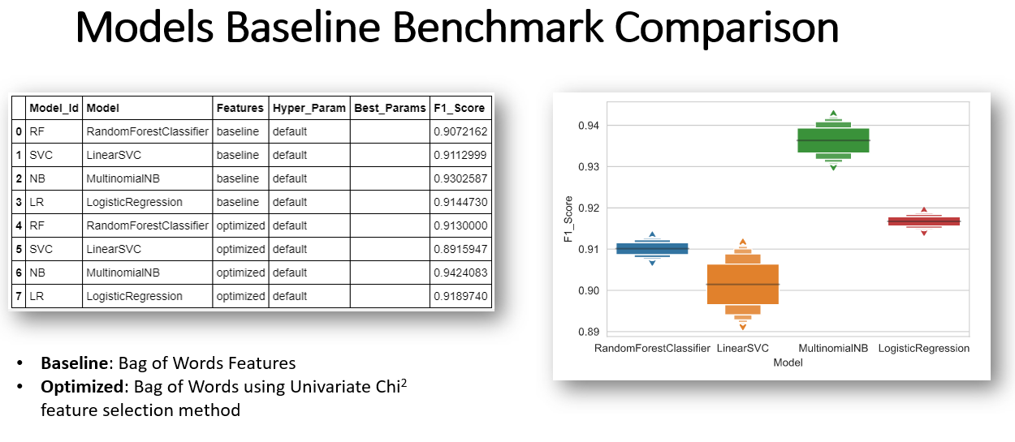
3.5 – Model Evaluation & Ensemble
Input | selfdialogs.db
Output | dialog_norm.csv
Data Preparation
Cleaning & NLP
Data Exploration
Feature Engineering & Selection
Model Evaluation and Ensemble
Model Interpretation
Features Selected
Bag of Words
Univariate SelectKBest - chi2
Models Benchmark
Logistic Regression
Multinomial Naïve Bayes
Random Forest Classifier
Linear SVC
Optimized Parameters
GridSearchCV
Learning Curves
F1-Score
Errors
ROC Curves
AUC
Ensemble Learning
Bagging
Boosting
Stacking
Voting

Slide 29
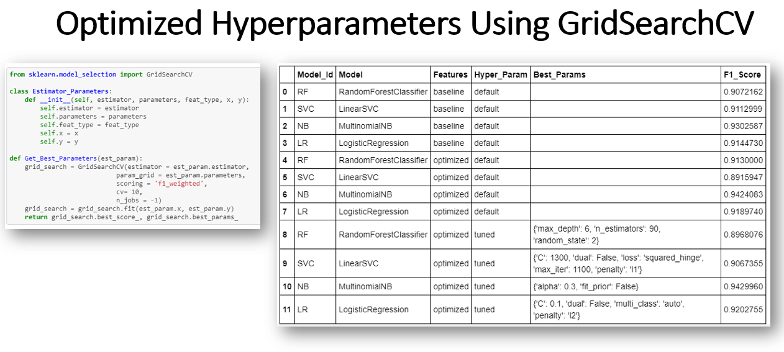
3.5 – Model Evaluation & Ensemble
Input | selfdialogs.db
Output | dialog_norm.csv
Data Preparation
Cleaning & NLP
Data Exploration
Feature Engineering & Selection
Model Evaluation and Ensemble
Model Interpretation
Features Selected
Bag of Words
Univariate SelectKBest - chi2
Models Benchmark
Logistic Regression
Multinomial Naïve Bayes
Random Forest Classifier
Linear SVC
Optimized Parameters
GridSearchCV
Learning Curves
F1-Score
Errors
ROC Curves
AUC
Ensemble Learning
Bagging
Boosting
Stacking
Voting

Slide 30
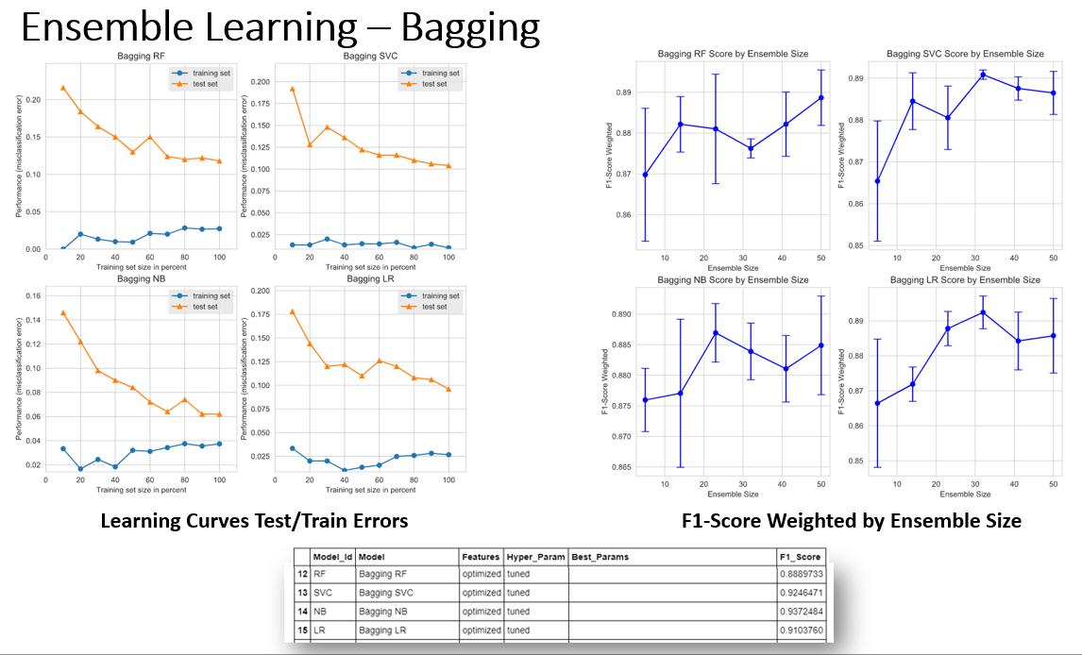
3.5 – Model Evaluation & Ensemble
Input | selfdialogs.db
Output | dialog_norm.csv
Data Preparation
Cleaning & NLP
Data Exploration
Feature Engineering & Selection
Model Evaluation and Ensemble
Model Interpretation
Features Selected
Bag of Words
Univariate SelectKBest - chi2
Models Benchmark
Logistic Regression
Multinomial Naïve Bayes
Random Forest Classifier
Linear SVC
Optimized Parameters
GridSearchCV
Learning Curves
F1-Score
Errors
ROC Curves
AUC
Ensemble Learning
Bagging
Boosting
Stacking
Voting

Slide 31
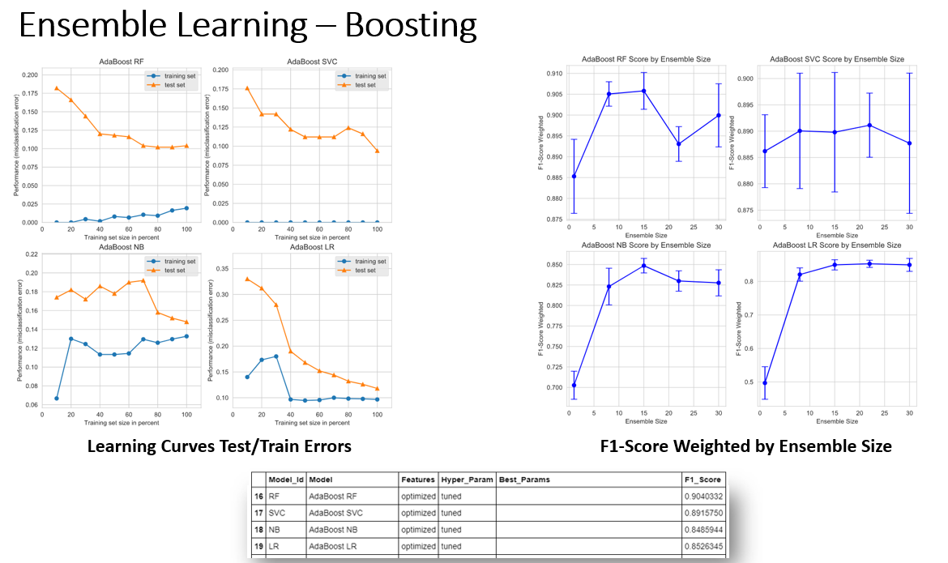
3.5 – Model Evaluation & Ensemble
Input | selfdialogs.db
Output | dialog_norm.csv
Data Preparation
Cleaning & NLP
Data Exploration
Feature Engineering & Selection
Model Evaluation and Ensemble
Model Interpretation
Features Selected
Bag of Words
Univariate SelectKBest - chi2
Models Benchmark
Logistic Regression
Multinomial Naïve Bayes
Random Forest Classifier
Linear SVC
Optimized Parameters
GridSearchCV
Learning Curves
F1-Score
Errors
ROC Curves
AUC
Ensemble Learning
Bagging
Boosting
Stacking
Voting

Slide 32
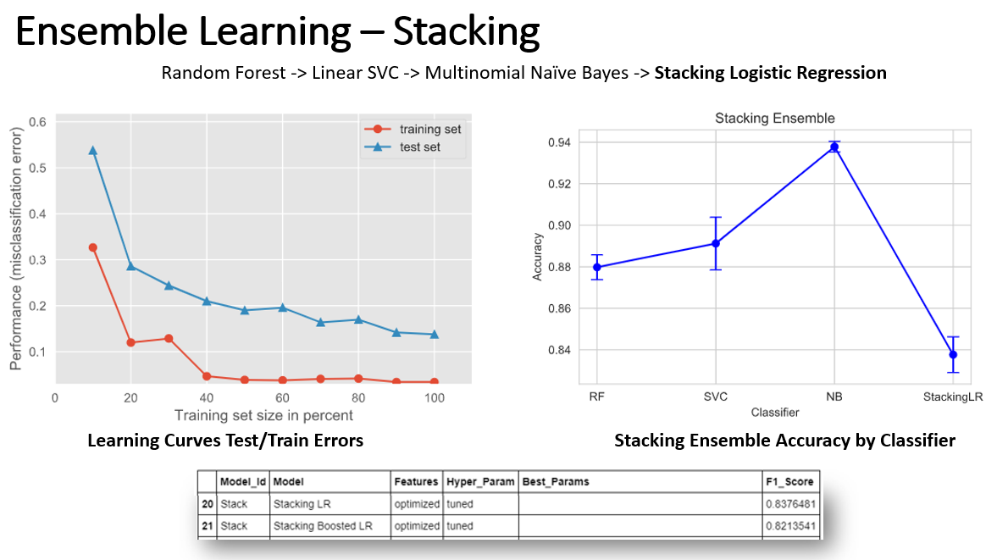
3.5 – Model Evaluation & Ensemble
Input | selfdialogs.db
Output | dialog_norm.csv
Data Preparation
Cleaning & NLP
Data Exploration
Feature Engineering & Selection
Model Evaluation and Ensemble
Model Interpretation
Features Selected
Bag of Words
Univariate SelectKBest - chi2
Models Benchmark
Logistic Regression
Multinomial Naïve Bayes
Random Forest Classifier
Linear SVC
Optimized Parameters
GridSearchCV
Learning Curves
F1-Score
Errors
ROC Curves
AUC
Ensemble Learning
Bagging
Boosting
Stacking
Voting

Slide 33
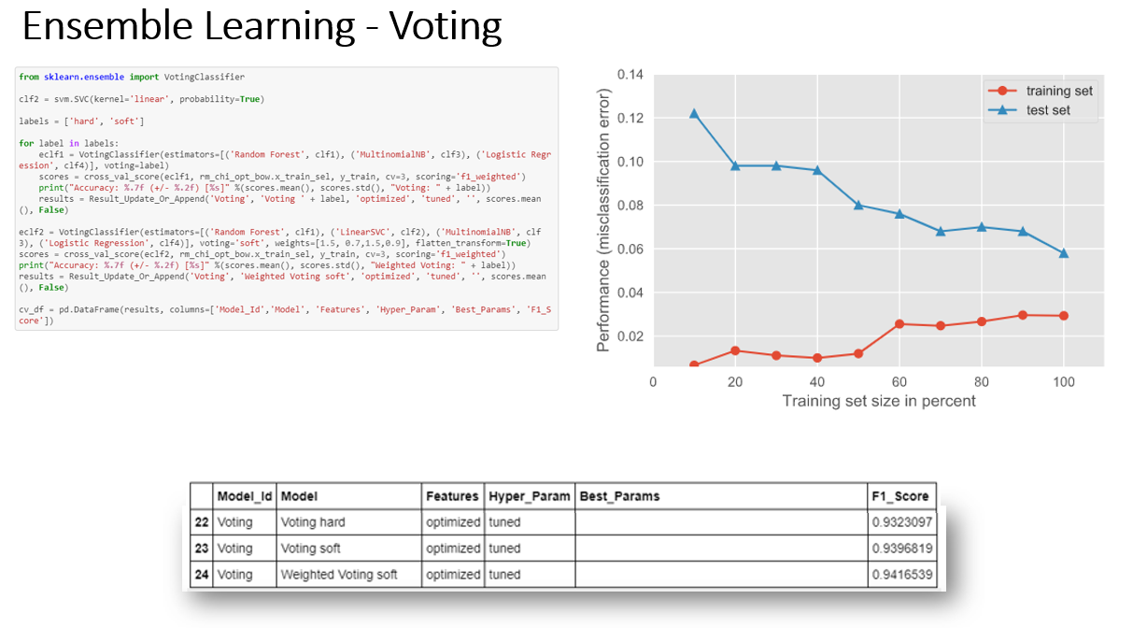
3.5 – Model Evaluation & Ensemble
Input | selfdialogs.db
Output | dialog_norm.csv
Data Preparation
Cleaning & NLP
Data Exploration
Feature Engineering & Selection
Model Evaluation and Ensemble
Model Interpretation
Features Selected
Bag of Words
Univariate SelectKBest - chi2
Models Benchmark
Logistic Regression
Multinomial Naïve Bayes
Random Forest Classifier
Linear SVC
Optimized Parameters
GridSearchCV
Learning Curves
F1-Score
Errors
ROC Curves
AUC
Ensemble Learning
Bagging
Boosting
Stacking
Voting

Slide 34
4. Results
4. Results
1. Baseline Model Benchmarks
2. Hyperparameter Tuning Benchmarks
3. Learning Curves
4. ROC Curve / AUC
5. Ensemble Learning Benchmarks
6. Overall Benchmarks

Slide 35
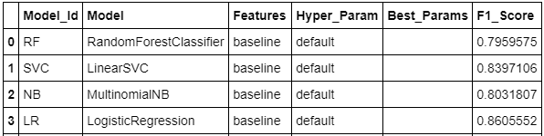
Results
Input | selfdialogs.db
Output | dialog_norm.csv
Feature Engineering
Model Evaluation
Learning Curves
Ensemble Learning
Model Selection
Baseline Models Benchmarks
Feature Optimized Models Benchmarks
Hyperparameter Tuned Benchmarks
Learning Curves
ROC Curves / AUC
Bagging Ensemble Learning Benchmarks
Training / Testing Errors
F1-Score by Ensemble Size
Boosting Ensemble Learning Benchmarks
Training / Testing Errors
F1-Score by Ensemble Size
Stacking Ensemble Learning Benchmarks
Training / Testing Errors
F1-Score by Classifier
Voting Ensemble Learning Benchmarks
Training / Testing Errors
Overall Benchmarks
Baseline Models Benchmarks

Slide 36
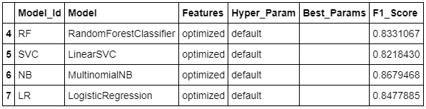
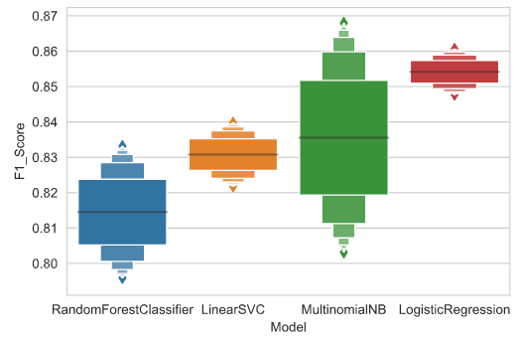
Results
Input | selfdialogs.db
Output | dialog_norm.csv
Feature Engineering
Model Evaluation
Learning Curves
Ensemble Learning
Model Selection
Baseline Models Benchmarks
Feature Optimized Models Benchmarks
Hyperparameter Tuned Benchmarks
Learning Curves
ROC Curves / AUC
Bagging Ensemble Learning Benchmarks
Training / Testing Errors
F1-Score by Ensemble Size
Boosting Ensemble Learning Benchmarks
Training / Testing Errors
F1-Score by Ensemble Size
Stacking Ensemble Learning Benchmarks
Training / Testing Errors
F1-Score by Classifier
Voting Ensemble Learning Benchmarks
Training / Testing Errors
Overall Benchmarks
Feature Optimized Models Benchmarks
Comparison of Baseline and Feature Optimized Models Benchmarks.

Slide 37
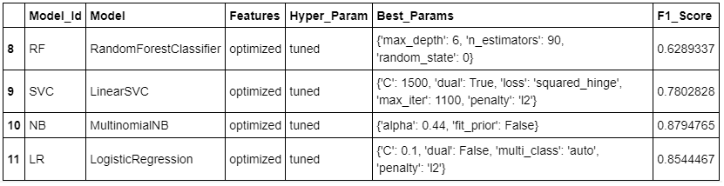
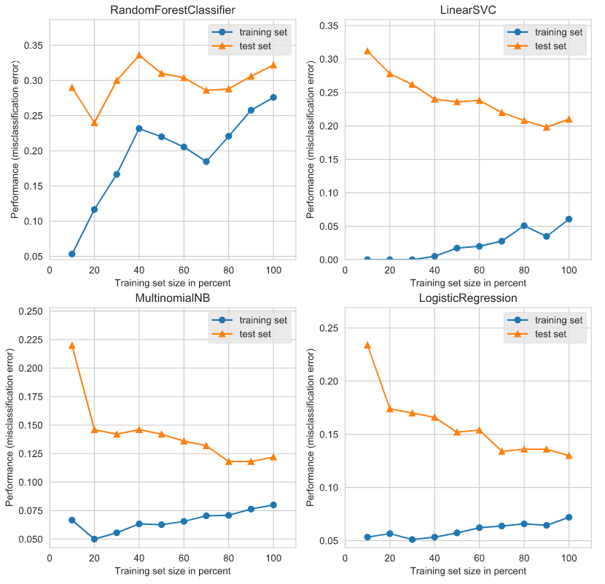
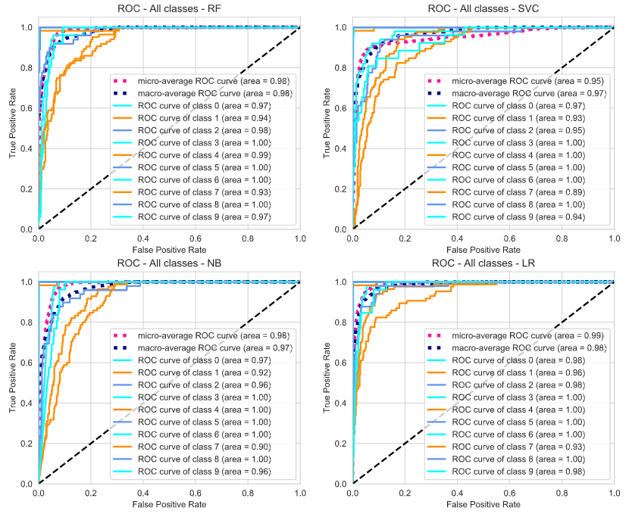
Results
Input | selfdialogs.db
Output | dialog_norm.csv
Feature Engineering
Model Evaluation
Learning Curves
Ensemble Learning
Model Selection
Baseline Models Benchmarks
Feature Optimized Models Benchmarks
Hyperparameter Tuned Benchmarks
Learning Curves
ROC Curves / AUC
Bagging Ensemble Learning Benchmarks
Training / Testing Errors
F1-Score by Ensemble Size
Boosting Ensemble Learning Benchmarks
Training / Testing Errors
F1-Score by Ensemble Size
Stacking Ensemble Learning Benchmarks
Training / Testing Errors
F1-Score by Classifier
Voting Ensemble Learning Benchmarks
Training / Testing Errors
Overall Benchmarks
Hyperparameters Tuned Benchmarks
Training / Testing Errors
ROC Curves / AUC

Slide 38
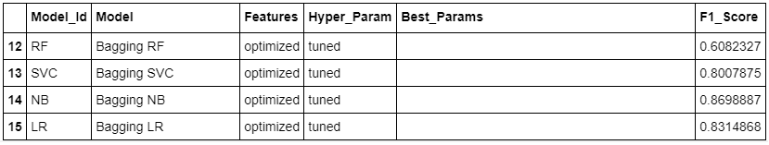
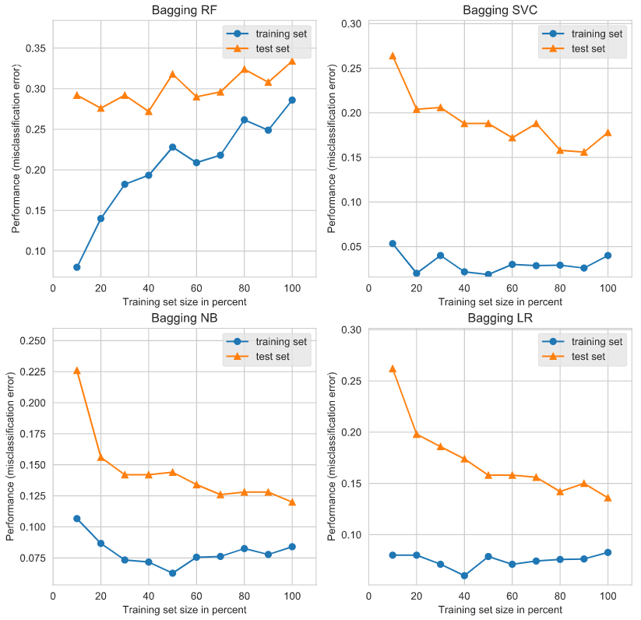
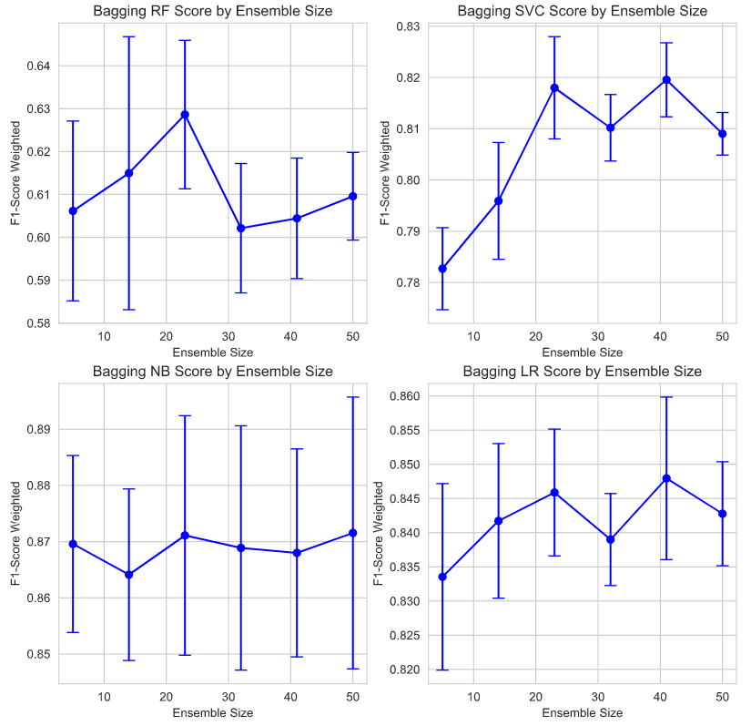
Results
Input | selfdialogs.db
Output | dialog_norm.csv
Feature Engineering
Model Evaluation
Learning Curves
Ensemble Learning
Model Selection
Baseline Models Benchmarks
Feature Optimized Models Benchmarks
Hyperparameter Tuned Benchmarks
Learning Curves
ROC Curves / AUC
Bagging Ensemble Learning Benchmarks
Training / Testing Errors
F1-Score by Ensemble Size
Boosting Ensemble Learning Benchmarks
Training / Testing Errors
F1-Score by Ensemble Size
Stacking Ensemble Learning Benchmarks
Training / Testing Errors
F1-Score by Classifier
Voting Ensemble Learning Benchmarks
Training / Testing Errors
Overall Benchmarks
Bagging Ensemble Learning Benchmarks
Training / Testing Errors
F1-Score By Ensemble Size

Slide 39
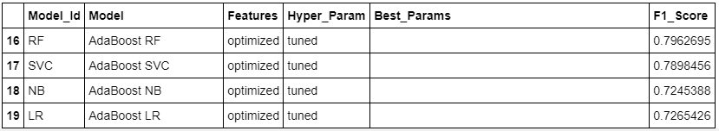
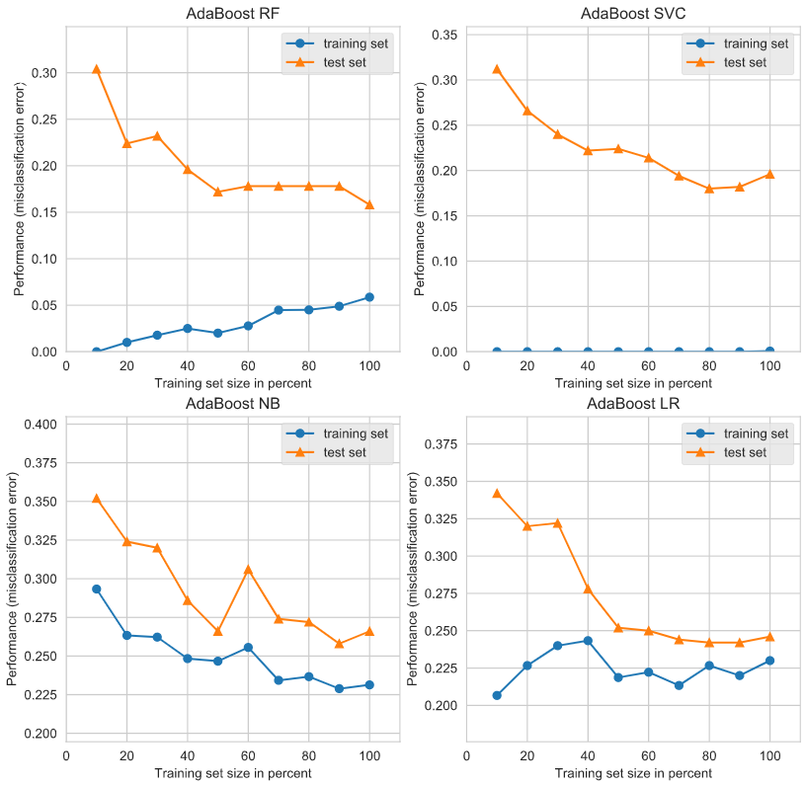
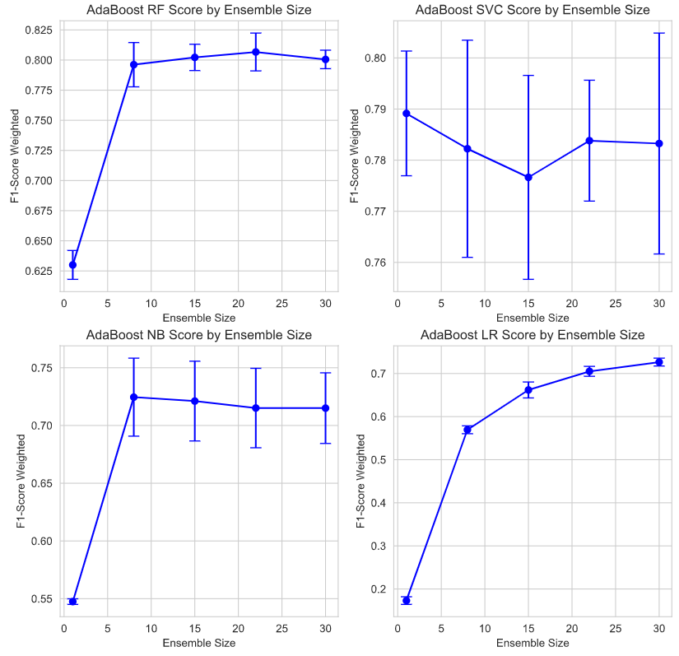
Results
Input | selfdialogs.db
Output | dialog_norm.csv
Feature Engineering
Model Evaluation
Learning Curves
Ensemble Learning
Model Selection
Baseline Models Benchmarks
Feature Optimized Models Benchmarks
Hyperparameter Tuned Benchmarks
Learning Curves
ROC Curves / AUC
Bagging Ensemble Learning Benchmarks
Training / Testing Errors
F1-Score by Ensemble Size
Boosting Ensemble Learning Benchmarks
Training / Testing Errors
F1-Score by Ensemble Size
Stacking Ensemble Learning Benchmarks
Training / Testing Errors
F1-Score by Classifier
Voting Ensemble Learning Benchmarks
Training / Testing Errors
Overall Benchmarks
Boosting Ensemble Learning Benchmarks
Training / Testing Errors
F1-Score By Ensemble Size

Slide 40
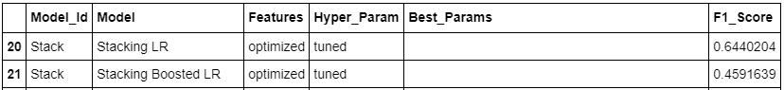


Results
Input | selfdialogs.db
Output | dialog_norm.csv
Feature Engineering
Model Evaluation
Learning Curves
Ensemble Learning
Model Selection
Baseline Models Benchmarks
Feature Optimized Models Benchmarks
Hyperparameter Tuned Benchmarks
Learning Curves
ROC Curves / AUC
Bagging Ensemble Learning Benchmarks
Learning Curves
F1-Score by Ensemble Size
Boosting Ensemble Learning Benchmarks
Learning Curves
F1-Score by Ensemble Size
Stacking Ensemble Learning Benchmarks
Training / Testing Errors
F1-Score by Classifier
Voting Ensemble Learning Benchmarks
Training / Testing Errors
Overall Benchmarks
Stacking Ensemble Learning Benchmarks
Random Forest -> Linear SVC -> Multinomial Naïve Bayes -> Stacking Logistic Regression
Training / Testing Errors
F1-Score By Classifier

Slide 41


Results
Input | selfdialogs.db
Output | dialog_norm.csv
Feature Engineering
Model Evaluation
Learning Curves
Ensemble Learning
Model Selection
Baseline Models Benchmarks
Feature Optimized Models Benchmarks
Hyperparameter Tuned Benchmarks
Learning Curves
ROC Curves / AUC
Bagging Ensemble Learning Benchmarks
Learning Curves
F1-Score by Ensemble Size
Boosting Ensemble Learning Benchmarks
Learning Curves
F1-Score by Ensemble Size
Stacking Ensemble Learning Benchmarks
Learning Curves
F1-Score by Ensemble Size
Voting Ensemble Learning Benchmarks
Training / Testing Errors
Overall Benchmarks
Voting Ensemble Learning Benchmarks
Training / Testing Errors
Voting Classifier supports two types of voting:
hard: the final class prediction is made by a majority vote — the estimator chooses the class prediction that occurs most frequently among the base models
soft: the final class prediction is made based on the average probability calculated using all the base model predictions.

Slide 42

Results
Input | selfdialogs.db
Output | dialog_norm.csv
Feature Engineering
Model Evaluation
Learning Curves
Ensemble Learning
Model Selection
Baseline Models Benchmarks
Feature Optimized Models Benchmarks
Hyperparameter Tuned Benchmarks
Learning Curves
ROC Curves / AUC
Bagging Ensemble Learning Benchmarks
Learning Curves
F1-Score by Ensemble Size
Boosting Ensemble Learning Benchmarks
Learning Curves
F1-Score by Ensemble Size
Stacking Ensemble Learning Benchmarks
Learning Curves
F1-Score by Ensemble Size
Voting Ensemble Learning Benchmarks
Training / Testing Errors
Overall Benchmarks

Slide 43

Results
Input | selfdialogs.db
Output | dialog_norm.csv
Feature Engineering
Model Evaluation
Learning Curves
Ensemble Learning
Model Selection
Baseline Models Benchmarks
Feature Optimized Models Benchmarks
Hyperparameter Tuned Benchmarks
Learning Curves
ROC Curves / AUC
Bagging Ensemble Learning Benchmarks
Learning Curves
F1-Score by Ensemble Size
Boosting Ensemble Learning Benchmarks
Learning Curves
F1-Score by Ensemble Size
Stacking Ensemble Learning Benchmarks
Learning Curves
F1-Score by Ensemble Size
Voting Ensemble Learning Benchmarks
Training / Testing Errors
Overall Benchmarks

Slide 44

Results
Input | selfdialogs.db
Output | dialog_norm.csv
Feature Engineering
Model Evaluation
Learning Curves
Ensemble Learning
Model Selection
Baseline Models Benchmarks
Feature Optimized Models Benchmarks
Hyperparameter Tuned Benchmarks
Learning Curves
ROC Curves / AUC
Bagging Ensemble Learning Benchmarks
Learning Curves
F1-Score by Ensemble Size
Boosting Ensemble Learning Benchmarks
Learning Curves
F1-Score by Ensemble Size
Stacking Ensemble Learning Benchmarks
Learning Curves
F1-Score by Ensemble Size
Voting Ensemble Learning Benchmarks
Training / Testing Errors
Overall Benchmarks

Slide 45
5. Discussion
5. Discussion
Comparison and Analysis Confusion Matrix from M1 and M2 Comparison of the progression: from baseline thru ensemble Comparison of 2000 & 4000 records: Learning Curves and F1-Score (covers the bias-variance tradeoff)
Interpreting and Explaining Models
General Trends Please add a discussion section about the general trends you see in the different combination you tried.

Slide 46


Comparison and Analysis
Input | selfdialogs.db
Output | dialog_norm.csv
Comparison and Analysis
Recommendations
Data Exploration
Model Interpretation
Comparison and Analysis
Confusion Matrix from M1 and M2
Comparison of the progression: from baseline thru ensemble
Comparison of 2000 & 4000 records: Learning Curves and F1-Score (covers the bias-variance tradeoff)
Interpreting and Explaining Models
Feature Importance
Individual Tree Visualization
ELI5
LIME
Skater
At End of Feature Selection
At the End of the Model Selection
Comparison of the confusion matrices at the end of feature selection and end of model evaluation and selection gives a visual of how the results improved.

Slide 47
Comparison and Analysis
Comparison and Analysis
Recommendations
Data Exploration
Model Interpretation
Comparison and Analysis
Confusion Matrix from M1 and M2
Comparison of the progression: from baseline thru ensemble
Comparison of 2000 & 4000 records: Learning Curves and F1-Score (covers the bias-variance tradeoff)
Interpreting and Explaining Models
Feature Importance
Individual Tree Visualization
ELI5
LIME
Skater
Comparison of the Progression from baseline thru ensemble learning

Slide 48
Comparison and Analysis
Input | selfdialogs.db
Output | dialog_norm.csv
Comparison and Analysis
Recommendations
Data Exploration
Model Interpretation
Comparison and Analysis
Confusion Matrix from M1 and M2
Comparison of the progression: from baseline thru ensemble
Comparison of 2000 & 4000 records: Learning Curves and F1-Score (covers the bias-variance tradeoff)
Interpreting and Explaining Models
Feature Importance
Individual Tree Visualization
ELI5
LIME
Skater
Comparison of the Progression from baseline thru ensemble learning

Slide 49
Comparison and Analysis
Input | selfdialogs.db
Output | dialog_norm.csv
Comparison and Analysis
Recommendations
Data Exploration
Model Interpretation
Comparison and Analysis
Confusion Matrix from M1 and M2
Comparison of the progression: from baseline thru ensemble
Comparison of 2000 & 4000 records: Learning Curves and F1-Score (covers the bias-variance tradeoff)
Interpreting and Explaining Models
Feature Importance
Individual Tree Visualization
ELI5
LIME
Skater
Comparison of the Progression from baseline thru ensemble learning
The RF, SVC, NB and LR violins are showing the variance from the baseline thru the ensemble learning for the different model types. The general trend is an improvement up to the tuning of the hyperparameters.
Generally, the ensemble learning methods did not score better than the models with optimized features and hyperparameters tuned. However the voting ensemble almost matched the best tuned models.

Slide 50


Input | selfdialogs.db
Output | dialog_norm.csv
Comparison and Analysis
Recommendations
Data Exploration
Model Interpretation
Comparison and Analysis
Confusion Matrix from M1 and M2
Comparison of the progression: from baseline thru ensemble
Comparison of 2000 & 4000 records: Learning Curves and F1-Score (covers the bias-variance tradeoff)
Interpreting and Explaining Models
Feature Importance
Individual Tree Visualization
ELI5
LIME
Skater
Training /Testing Errors 2000 Samples
Training /Testing Errors 4000 Samples
Increasing the number of samples reduces the overall error, which reduces bias.
Taking into consideration the Y-Axis on the scale:
the variance gap is not significantly changed for all model types
The error is reduced for all model types

Slide 51

3.6 – Model Interpretation
Input | selfdialogs.db
Output | dialog_norm.csv
Data Preparation
Cleaning & NLP
Data Exploration
Feature Engineering & Selection
Model Evaluation and Ensemble
Model Interpretation
Comparison and Analysis
Confusion Matrix from M1 and M2
Comparison of the progression: from baseline thru ensemble
Comparison of 2000 & 4000 records: Learning Curves and F1-Score (covers the bias-variance tradeoff)
Interpreting and Explaining Models
Feature Importance
Individual Tree Visualization
ELI5
LIME
Skater

Slide 52

3.6 – Model Interpretation
Input | selfdialogs.db
Output | dialog_norm.csv
Data Preparation
Cleaning & NLP
Data Exploration
Feature Engineering & Selection
Model Evaluation and Ensemble
Model Interpretation
Comparison and Analysis
Confusion Matrix from M1 and M2
Comparison of the progression: from baseline thru ensemble
Comparison of 2000 & 4000 records: Learning Curves and F1-Score (covers the bias-variance tradeoff)
Interpreting and Explaining Models
Feature Importance
Individual Tree Visualization
ELI5
LIME
Skater

Slide 53


3.6 – Model Interpretation
Input | selfdialogs.db
Output | dialog_norm.csv
Data Preparation
Cleaning & NLP
Data Exploration
Feature Engineering & Selection
Model Evaluation and Ensemble
Model Interpretation
Comparison and Analysis
Confusion Matrix from M1 and M2
Comparison of the progression: from baseline thru ensemble
Comparison of 2000 & 4000 records: Learning Curves and F1-Score (covers the bias-variance tradeoff)
Interpreting and Explaining Models
Feature Importance
Individual Tree Visualization
ELI5
LIME
Skater

Slide 54


3.6 – Model Interpretation
Input | selfdialogs.db
Output | dialog_norm.csv
Data Preparation
Cleaning & NLP
Data Exploration
Feature Engineering & Selection
Model Evaluation and Ensemble
Model Interpretation
Comparison and Analysis
Confusion Matrix from M1 and M2
Comparison of the progression: from baseline thru ensemble
Comparison of 2000 & 4000 records: Learning Curves and F1-Score (covers the bias-variance tradeoff)
Interpreting and Explaining Models
Feature Importance
Individual Tree Visualization
ELI5
LIME
Skater

Slide 55

3.6 – Model Interpretation
Input | selfdialogs.db
Output | dialog_norm.csv
Data Preparation
Cleaning & NLP
Data Exploration
Feature Engineering & Selection
Model Evaluation and Ensemble
Model Interpretation
Comparison and Analysis
Confusion Matrix from M1 and M2
Comparison of the progression: from baseline thru ensemble
Comparison of 2000 & 4000 records: Learning Curves and F1-Score (covers the bias-variance tradeoff)
Interpreting and Explaining Models
Feature Importance
Individual Tree Visualization
ELI5
LIME
Skater

Slide 56

3.6 – Model Interpretation
Input | selfdialogs.db
Output | dialog_norm.csv
Data Preparation
Cleaning & NLP
Data Exploration
Feature Engineering & Selection
Model Evaluation and Ensemble
Model Interpretation
Comparison and Analysis
Confusion Matrix from M1 and M2
Comparison of the progression: from baseline thru ensemble
Comparison of 2000 & 4000 records: Learning Curves and F1-Score (covers the bias-variance tradeoff)
Interpreting and Explaining Models
Feature Importance
Individual Tree Visualization
ELI5
LIME
Skater

Slide 57
6. Conclusion
6. Conclusion
Recommendations Model chosen Discussion of Naïve Bayes with Hyperparameters and Voting Voting
Future Work

Slide 58



Conclusion
Input | selfdialogs.db
Output | dialog_norm.csv
Data Preparation
Cleaning & NLP
Data Exploration
Feature Engineering & Selection
Model Evaluation and Ensemble
Model Interpretation
Recommendations
Discussion of Naïve Bayes with Hyperparameters and Voting
Model chosen
Future Work
The Naïve Bayes with optimized features and tuned hyperparameters and the ensemble weighted voting soft gave us our best results.
Both the variance and bias are slightly improved for the ensemble voting model, indicating a more robust model.

Slide 59
Conclusion
Input | selfdialogs.db
Output | dialog_norm.csv
Data Preparation
Cleaning & NLP
Data Exploration
Feature Engineering & Selection
Model Evaluation and Ensemble
Model Interpretation
Recommendations
Discussion of Naïve Bayes with Hyperparameters and Voting
Model chosen
Future Work
Based on our results, the recommended model to proceed with is:
Weighted Voting Ensemble (Soft Voting)

Slide 60
Future Work
Input | selfdialogs.db
Output | dialog_norm.csv
Data Preparation
Cleaning & NLP
Data Exploration
Feature Engineering & Selection
Model Evaluation and Ensemble
Model Interpretation
Conclusion
Recommendations
Model chosen
Discussion of Naïve Bayes with Hyperparameters and Voting
Future Work

Slide 61
Future Work
Input | selfdialogs.db
Output | dialog_norm.csv
Data Preparation
Cleaning & NLP
Data Exploration
Feature Engineering & Selection
Model Evaluation and Ensemble
Model Interpretation
Conclusion
Recommendations
Model chosen
Discussion of Naïve Bayes with Hyperparameters and Voting
Future Work

Slide 62
References / Bibliography
Upasana, Mar. 17, 2017, Imbalanced Data : How to handle Imbalanced Classification Problems https://www.analyticsvidhya.com/blog/2017/03/imbalanced-data-classification/
Li, Susan, Feb 19, 2018, Multi-Class Text Classification with Scikit-Learn https://towardsdatascience.com/multi-class-text-classification-with-scikit-learn-12f1e60e0a9f
Sarkar, Dipanjan (DJ), Jan 6, 2018, Categorical Data, Strategies for working with discrete, categorical data https://towardsdatascience.com/understanding-feature-engineering-part-2-categorical-data-f54324193e63
Jaadi, Zakaria, September 4, 2019, Updated: February 24, 2020, A Step By Step Explanation Of Principal Component Analysis https://builtin.com/data-science/step-step-explanation-principal-component-analysis
Powell, Victor, Lehe, Lewis, Principal Component Analysis, Explained Visually https://setosa.io/ev/principal-component-analysis/
scikit-learn 0.22.2, Receiver Operating Characteristic (ROC) https://scikit-learn.org/stable/auto_examples/model_selection/plot_roc.html
Vallantin, Lima, Oct 9, 2018, Metrics to measure machine learning model performance https://medium.com/@limavallantin/metrics-to-measure-machine-learning-model-performance-e8c963665476
Borges, Diogo Menezes Jan. 2019, Ensemble Learning: 5 Main Approaches https://www.kdnuggets.com/2019/01/ensemble-learning-5-main-approaches.html
Smolyakov, Vadim, Aug. ,22, 2017, Ensemble Learning to Improve Machine Learning Results, https://blog.statsbot.co/ensemble-learning-d1dcd548e936
Koehrsen, Will, May 18, 2018, A Complete Machine Learning Walk-Through in Python: Part Three, Interpreting a machine learning model and presenting results https://towardsdatascience.com/a-complete-machine-learning-walk-through-in-python-part-three-388834e8804b
Hulstaert, Lars, Feb 20, 2018, Interpreting machine learning models https://towardsdatascience.com/interpretability-in-machine-learning-70c30694a05f

Slide 63
References / Bibliography
Ma, Edward, Jul 29, 2018, 3 ways to interpretate your NLP model to management and customer https://towardsdatascience.com/3-ways-to-interpretate-your-nlp-model-to-management-and-customer-5428bc07ce15
Li, Susan, Jul 3, 2019, Explain NLP models with LIME & SHAP, Interpretation for Text Classification https://towardsdatascience.com/explain-nlp-models-with-lime-shap-5c5a9f84d59b
scikit-learn 0.23.0, 3.2. Tuning the hyper-parameters of an estimator https://scikit-learn.org/stable/modules/grid_search.html#grid-search
NLP in Python - Quickstart Guide https://github.com/NirantK/nlp-python-deep-learning
Kessler, Jason, Beautiful visualizations of how language differs among document types. https://github.com/JasonKessler/scattertext
Seaborn, 0.10.1, Building structured multi-plot grids https://seaborn.pydata.org/tutorial/axis_grids.html
AlammarThe, Jay, Dec. 3, 2018, Illustrated BERT, ELMo, and co. (How NLP Cracked Transfer Learning) https://jalammar.github.io/illustrated-bert/
Brownlee, Jason, May 20, 2016, Feature Selection For Machine Learning in Python https://machinelearningmastery.com/feature-selection-machine-learning-python/
Brownlee, Jason, July 14, 2014, Feature Selection in Python with Scikit-Learn https://machinelearningmastery.com/feature-selection-in-python-with-scikit-learn/
BY DATAFLAIR TEAM · UPDATED · OCTOBER 4, 2019 https://data-flair.training/blogs/machine-learning-classification-algorithms/
https://machinelearningmastery.com/how-to-reduce-model-variance/
Eryk Lewinson, Ensemble learning using the Voting Classifier https://levelup.gitconnected.com/ensemble-learning-using-the-voting-classifier-a28d450be64d

